Slide 1


Shehla Kulsum Baig
24-4-2024

Slide 2

Outline
Executive Summary
Introduction
Methodology
Results
Conclusion
Appendix

Slide 3
Executive Summary
Summary of methodologies:
Data Collection
Data Wrangling
EDA with SQL
EDA with data visualization
Building interactive map with Folium
Building Dashboard with plotly Dash
Predictive analysis using Classification
Summary of all results:
Exploratory Data Analysis (EDA) results
Interactive analytics results
Predictive analytics results

Slide 4
Introduction
Project background and context:
Here we use data analytics to predict whether first stage of SpaceX’s Falcon9 will land successfully. This will help us to determine total cost in case of successful launce. It is also important to determine cost of failure in case of unsuccessful launch.
Problems you want to find answers:
What factors are responsible for success or failure of rocket launch.
Find relationship between various parameters that will impact rocket launch
What is the accuracy for successful landing.
Which conditions will achieve higher success rate

Slide 5

Section 1

Slide 6
Methodology
Executive Summary
Data collection methodology:
SpaceX Rest API
Web scraping using Wikipidia
Perform data wrangling
Transform data and apply One Hot Encoding for ML feature selection
Perform exploratory data analysis (EDA) using visualization and SQL
EDA for feature engineering and Visualization techniques like Scatter plot, Bar graph to discover patterns in data.
Perform interactive visual analytics using Folium and Plotly Dash
Perform predictive analysis using classification models
Machine Learning algorithms for classification (LR, K-NN, SVM, Decission Tree) were used

Slide 7
Data Collection
1) Data was collected from open source SpaceX REST API. This data include info on rocket, Launchpad, payload, cores, etc.
2) Data was collected using web scraping Wikipedia using Beautiful Soup for Falcon 9 launch data
Request SpaceX Launch data
Get HTML response from Wikipedia
Create data frame for Falcon 9 launches
Extract data using Beautiful Soup
Replace missing payload value with mean
Clean the extracted data
Save data to CSV file dataset_part_2.csv
Save data to CSV file dataset_part_1.csv

Slide 8
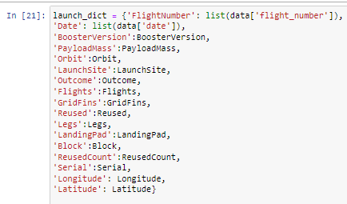
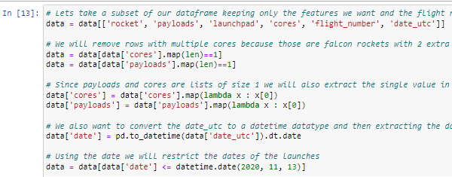
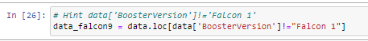
Data Collection – SpaceX API
GitHub Link : https://github.com/shehla1739/Applied-Data-Science-Capstone/blob/main/Week1%20-%20Lab1%20DataCollectWithAPI%20(1).ipynb
1 Getting Response from APT
4. Assign list to dictionary and then to dataframe
2. Converting Response to .json file
3. Apply custom function to clean data
5. Filter dataframe and export to .csv file

Slide 9
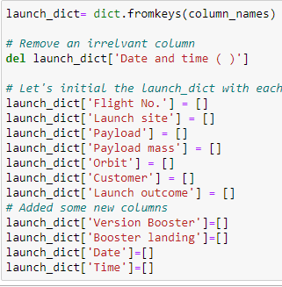
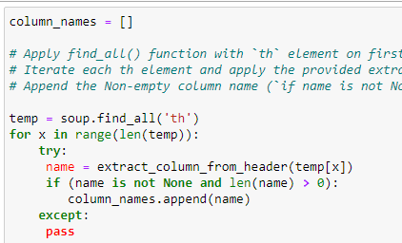
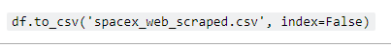
Data Collection - Scraping
GitHub: https://github.com/shehla1739/Applied-Data-Science-Capstone/blob/main/Week1%20-%20Data%20Collection%20With%20WebScrapingFalcon9.ipynb
1 Creating BeautifulSoup object
3. Creating the launch_dict
2. Getting column names
4. Converting to dataframe
5. Filter dataframe and export to .csv file

Slide 10
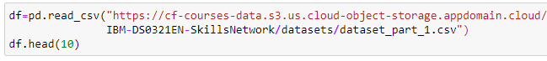
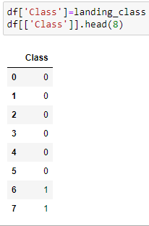
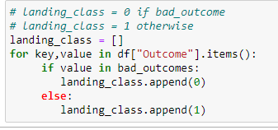
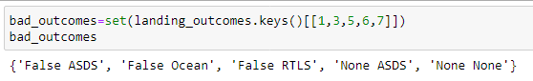
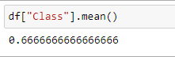
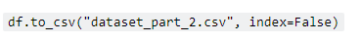
Data Wrangling
GitHub URL: https://github.com/shehla1739/Applied-Data-Science-Capstone/blob/main/Week%201%20-%20Lab2%20Data%20wrangling.ipynb
1 Load the dataset
4. Present outcomes as 0’s and 1’s
Code
2. Create landing outcome
3. Find the bad outcomes
5. Determine the success outcome
6. export to .csv file

Slide 11
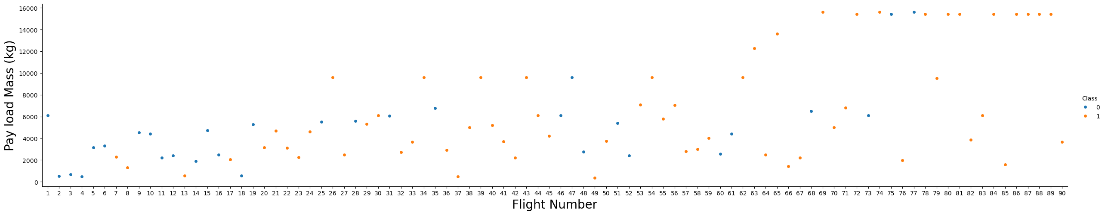
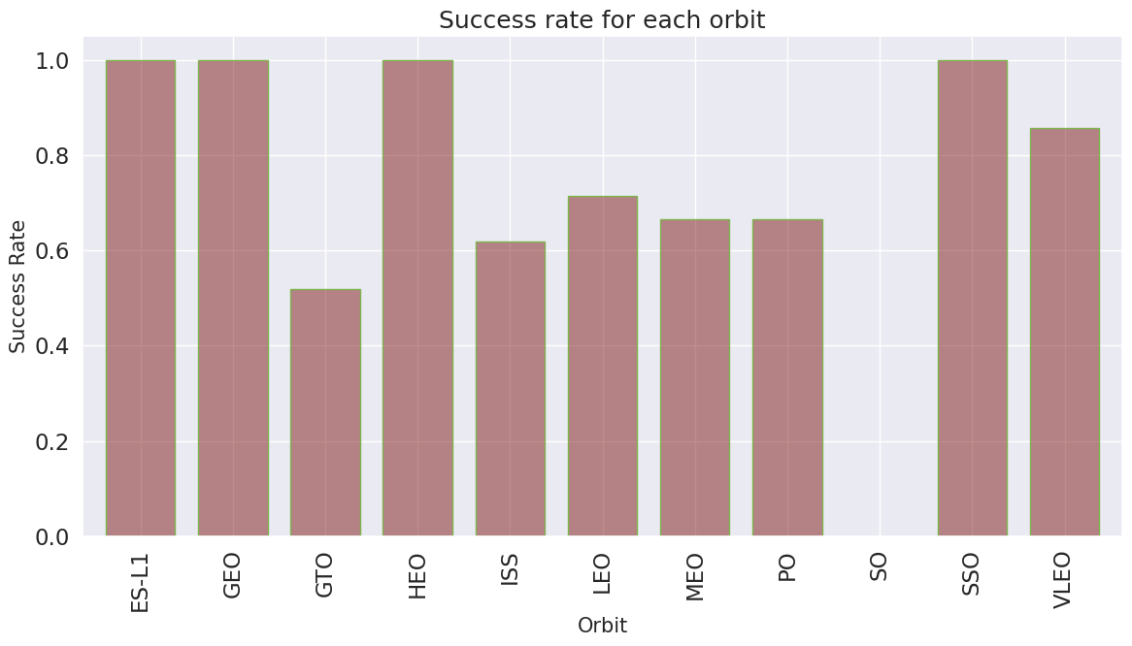
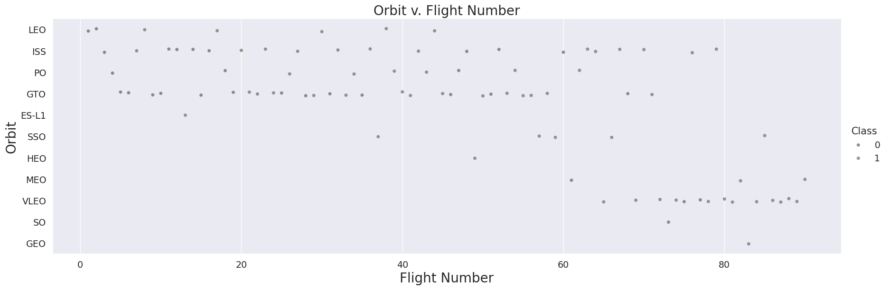
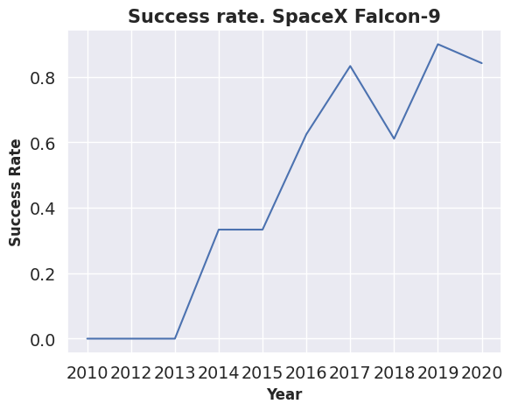
EDA with Data Visualization
GitHub URL: https://github.com/shehla1739/Applied-Data-Science-Capstone/blob/main/Week2%20-%20Explore%20and%20Prepare%20data%20-%20edadataviz.ipynb
Category plot between Flight number and Payload mass (Kg)
Bar chart between Orbit and success rate of each orbit
Scatter plot between Orbit and Flight number
Line chart between Year and Success rate

Slide 12
EDA with SQL
GitHub URL: https://github.com/shehla1739/Applied-Data-Science-Capstone/blob/main/Week2%20-%20labs%20SQL%20Notebook%20eda-sql-coursera_sqllite.ipynb
Following are SQL queries performed to gather information of dataset:
Display the names of the unique launch sites in the space mission
Display 5 records where launch sites begin with the string 'CCA'
Display the total payload mass carried by boosters launched by NASA (CRS)
Display average payload mass carried by booster version F9 v1.1
List the date when the first successful landing outcome in ground pad was achieved.
List the names of the boosters which have success in drone ship and have payload mass greater than 4000 but less than 6000
List the total number of successful and failure mission outcomes
List the names of the booster versions which have carried the maximum payload mass. Use a subquery
List the records which will display the month names, failure landing outcomes in drone ship ,booster versions, launch site for the months in year 2015.
Rank the count of landing outcomes (such as Failure (drone ship) or Success (ground pad)) between the date 2010-06-04 and 2017-03-20, in descending order.

Slide 13
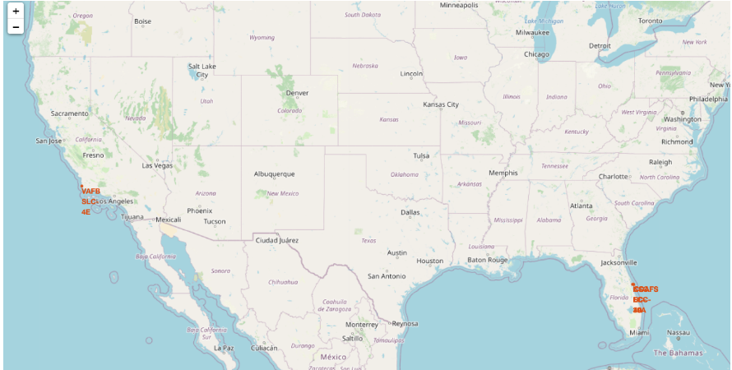
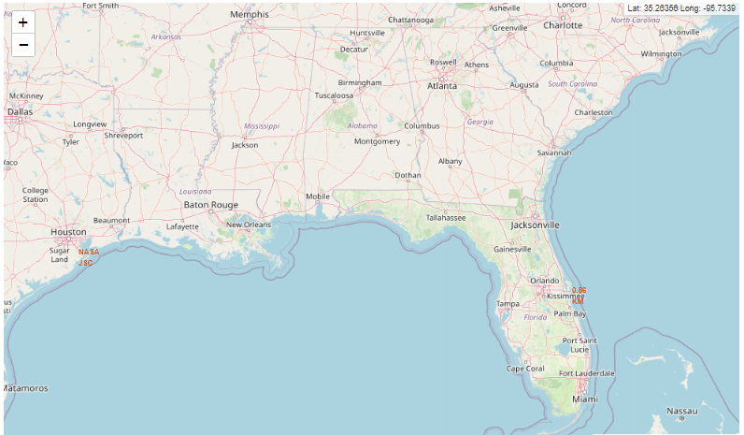
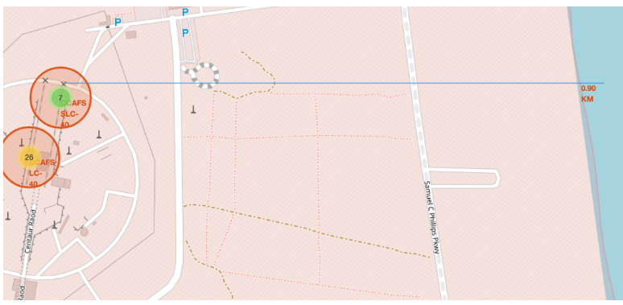
Build an Interactive Map with Folium
GitHub URL: https://github.com/shehla1739/Applied-Data-Science-Capstone/blob/main/Week3%20-%20lab_launch_site_location.ipynb
Folium Interactive Map was used to visualize and analyze SpaceX Launch Sites. The distance between a launch site was claculated by using longitude and latitude coordinate information.
To create markers on map, folium.Marker() was used. To create circles folium.Circles() was used. To create icons on map folium.icon was used. Folium.polyLine() was used to create polynomial lines between the points.
The successful and failed launches for each site on map were identified by assigning launch_outcome(failures, successes) to class 0 / 1 with red and green marhers on the map in a MarkerCluster()

Slide 14
Build a Dashboard with Plotly Dash
The interactive dashboard were build using Plotly and Dash.
The Dropdown menu is provided for selecting launch sites. The default select value is for ALL sites
The pie chart is used to show the total successful launches count for all sites. If a specific launch site was selected, then it shows the Success vs. Failed counts for the site
Scatter chart were used for displaying launch site, payload mass, success/failure.
A scatter chart is used to show the correlation between payload and launch success. A callback function is used for `site-dropdown` as input, `success-pie-chart` as output. Another callback function is added for `site-dropdown` and `payload-slider` as inputs, `success-payload-scatter-chart` as output.
GitHub URL:
https://github.com/shehla1739/Applied-Data-Science-Capstone/blob/main/Week3%20-%20spacex_dash_app.py

Slide 15
Predictive Analysis (Classification)
GitHub URL: https://github.com/shehla1739/Applied-Data-Science-Capstone/blob/main/Week4%20-%20SpaceX_Machine%20Learning%20Prediction_Part_5.ipynb
Model Building:
Load dataset into Numpy and Pandas
Transform data
Split data into training and testing datasets
Select machine learning algo to use and set parameter
Train the ML model using training dataset
Model Building:
Load dataset into Numpy and Pandas
Transform data
Split data into training and testing datasets
Select machine learning algo to use and set parameter
Train the ML model using training dataset
Model Evaluation:
Use testing dataset to check accuracy of ML Model
for each ML model use tuned hyper-parameter
plot Confusion Matrix for ML model being used
Model Evaluation:
Use testing dataset to check accuracy of ML Model
For each ML model use tuned hyper-parameter
Plot Confusion Matrix for ML model being used
Model Improving
Feature Engineering is used to improve model performance
Algorithm tuning is also used for model improvement

Slide 16
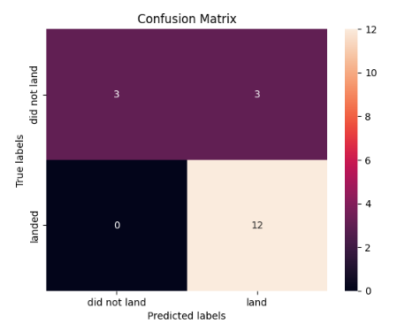
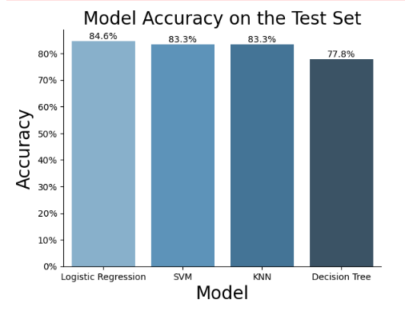
Results
GitHub URL: https://github.com/shehla1739/Applied-Data-Science-Capstone/blob/main/Week4%20-%20SpaceX_Machine%20Learning%20Prediction_Part_5.ipynb
The best Classification Model is the one with highest accuracy score. The models hyper-parameters were optimized using Scikit-learn GridSearchCV .
The Logistic Regression, SVM, KNN, model achieve accuracy of 83.3%, where as the accuracy of Decision Tree is 77.8%
For the given dataset, SVM, KNN, Logistic Regression model achieve best in terms of predictive accuracy

Slide 17

Section 2

Slide 18
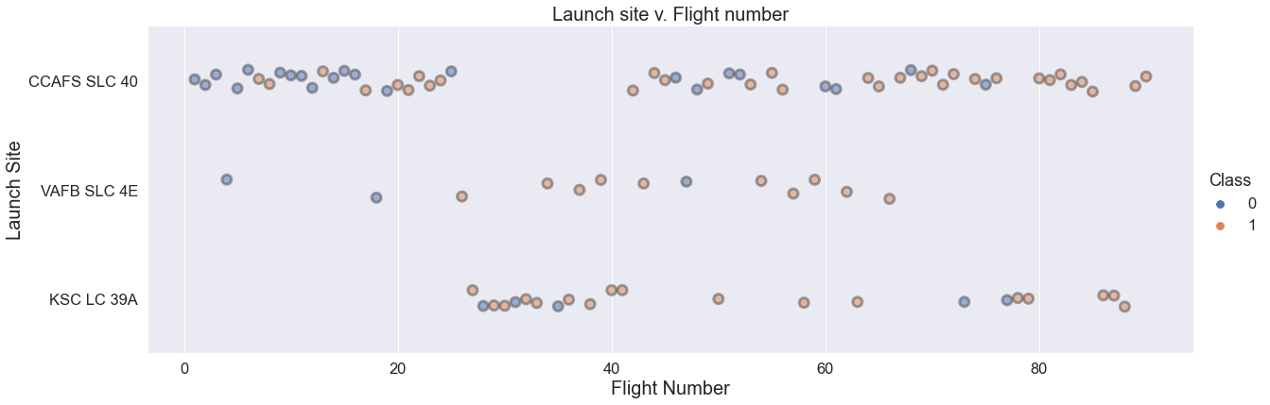
Flight Number vs. Launch Site
CCAFS SLC-40 is the most used launch site.
Launches from the site of CCAFS SLC-40 are significantly higher than launches form other sites
CCAFS SLC-40 has most of failures specially in the early stage

Slide 19
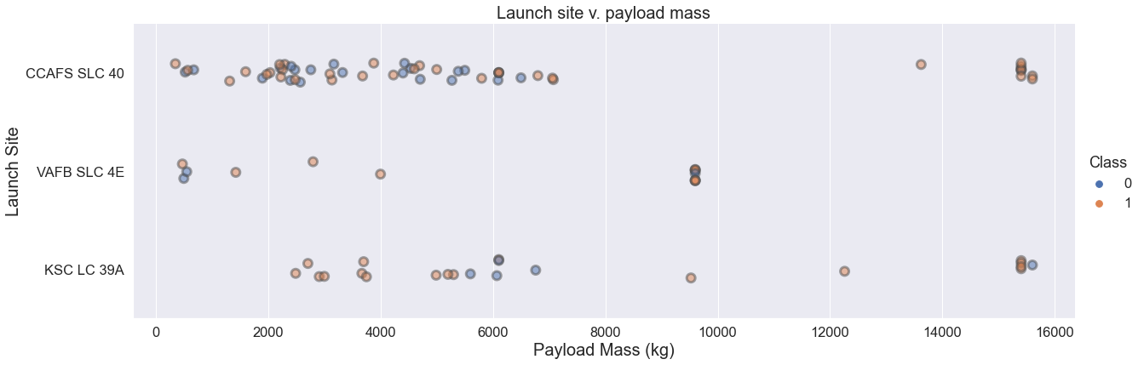
Payload vs. Launch Site
The percentage of failures is lower for heavy payload
The majority of payload with lower mass has been launched from CCAFS SLC 40
heavy payloads > 10000 kg are sent to low/medium orbits LEO/MEO only

Slide 20
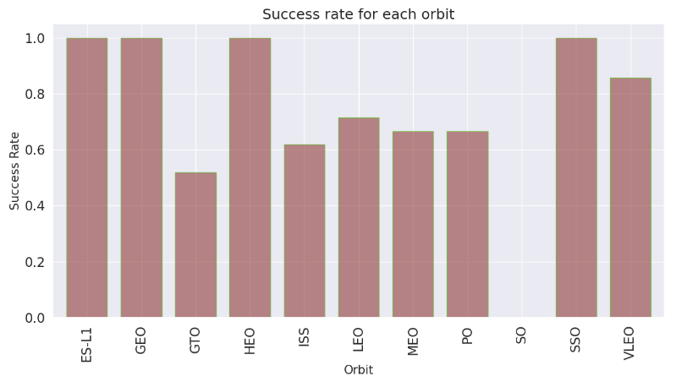
Success Rate vs. Orbit Type
Success rate may strongly depend payload mass and orbit.
Orbit GEO, HEO, SSO, ES-L1 has the highest success rate
GTO has the lowest success rate where as SSO (polar low orbit) the highest one.
ES-L1, GEO, HEO, SSO has success rate of 100% where as SO has success rate of 0%

Slide 21
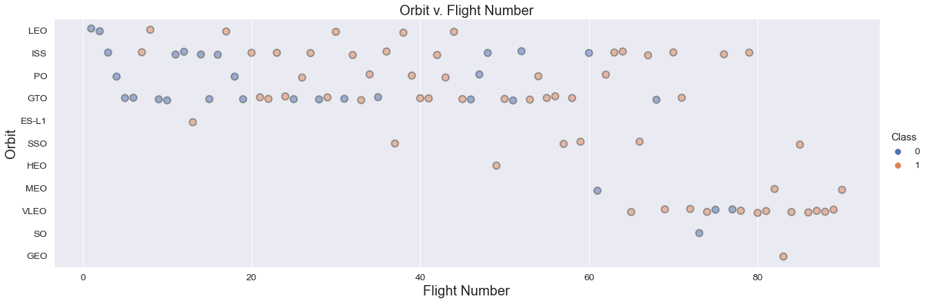
Flight Number vs. Orbit Type
PO, SSO, ISS, VLEO are low orbits
GTO is a transfer orbit to GEO.
The number of flights for: GEO, SO, HEO, ESL-1, MEO is not significant for concluding about success rate

Slide 22
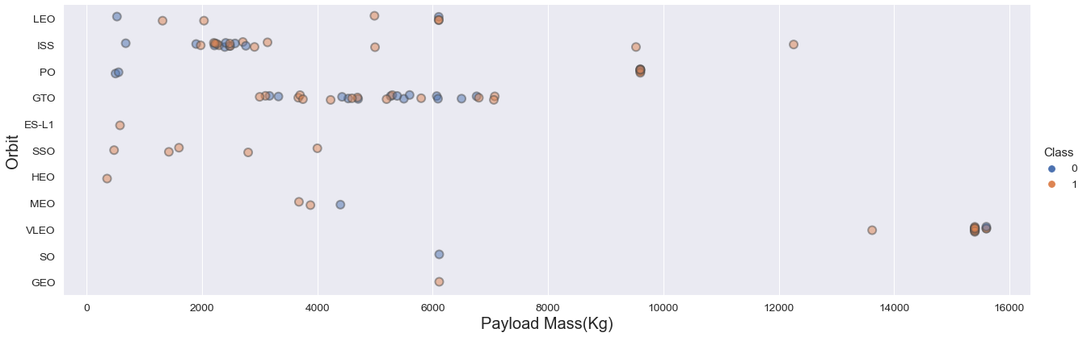
Payload vs. Orbit Type
Maximum success rate with: low orbit except (ISS) and low payload mass
Between 2000 and 7500 kg, success rate seems to be evenly distributed for GTO
Payload mass between 2000 and 3000 is affecting ISS
Payload mass between 3000 and 7000 is affecting GTO

Slide 23
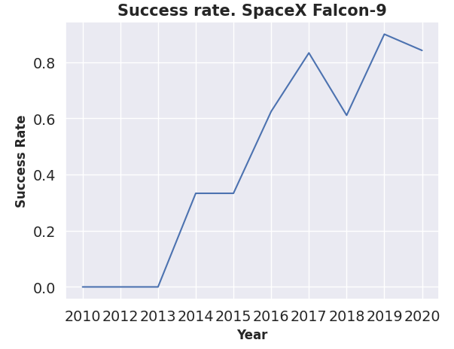
Launch Success Yearly Trend
From the line chart we observe that success rate significantly improved over time. There is increase in success rate from 2013 till 2017 then there is drop for year 2018 then again increase in success rate.

Slide 24
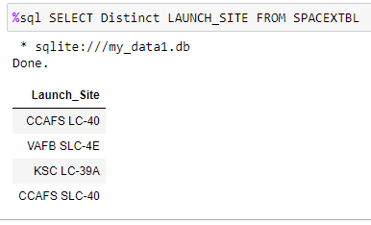
All Launch Site Names
Explanation:
DISTINCT keyword in SQL eliminates all duplicate records from the result returned by the SQL query. Therefore above SQL statement will return unique launch sites from tblSpaceX

Slide 25
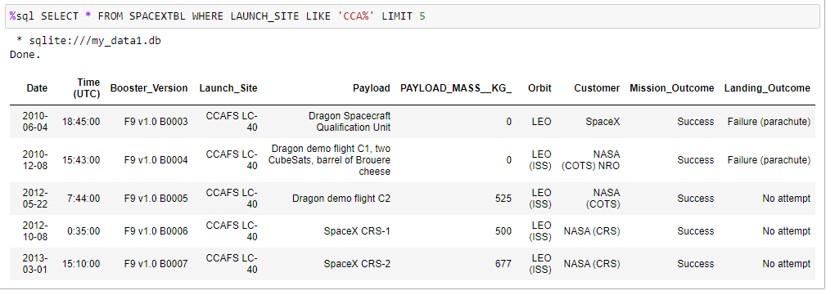
Launch Site Names Begin with 'CCA'
Explanation:
LIKE is a logical operator in SQL that allows you to match on similar values. Here we use CCA% to match all words beginning with CCA
The LIMIT clause is used to specify the number of records to return. Here we are retrieving 5 records.

Slide 26
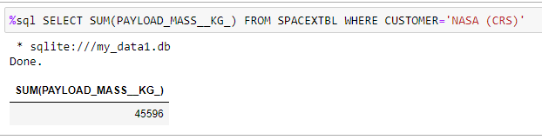
Total Payload Mass
Explanation:
The SUM() function returns the total sum of a numeric column. Here sum summates Total_Mass_Kg_ column
The WHERE clause specifies criteria that field values must meet for the records that contain the values to be included in the query results. Here where filters only those records where Customer is equal to NASA(CRS)

Slide 27
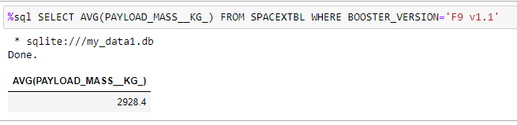
Average Payload Mass by F9 v1.1
Explanation:
The AVG() function returns the average value of a numeric column. Here we use avg() function to compute the average value on Payload_Mass_Kg_ column
The WHERE clause is used to filter records. Here Where clause is used to filter records where Booster_Version is equal to ‘F9v1.1’

Slide 28
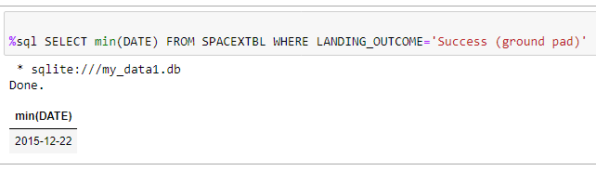
First Successful Ground Landing Date
Explanation:
The MIN() function returns the smallest value of the selected column. Here min() function is used on date column.
The WHERE clause is used to filter records. Here Where clause is used to filter records where Landing_Outcome is equal to Success(drone ship)

Slide 29
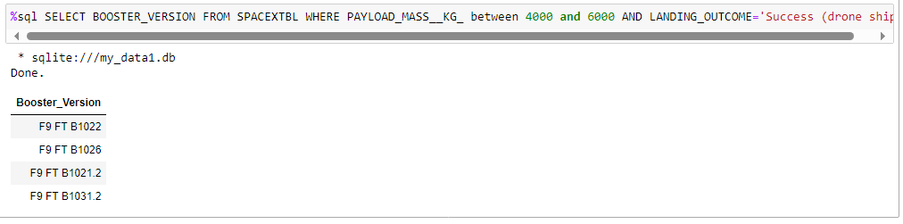
Successful Drone Ship Landing with Payload between 4000 and 6000
Explanation:
In above query select clause is used for selecting Booster Version
The where clause is used to filter records where Landing_Outcome is equal to Success(drone ship)
The AND operator displays a record if all the conditions separated by AND are TRUE. Here we use ‘and’ to filter condition Payload_Mass_Kg_> 4000 and Payload_Mass_Kg_< 6000

Slide 30
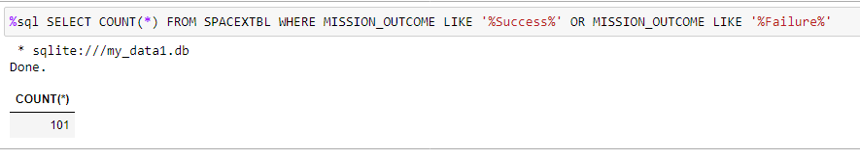
Total Number of Successful and Failure Mission Outcomes
Explanation:
In the above query The COUNT() function returns the number of records returned by a select query. The LIKE is a logical operator in SQL that allows you to match on similar values rather than exact ones. The above query is used to count total number of successful and failure missions

Slide 31
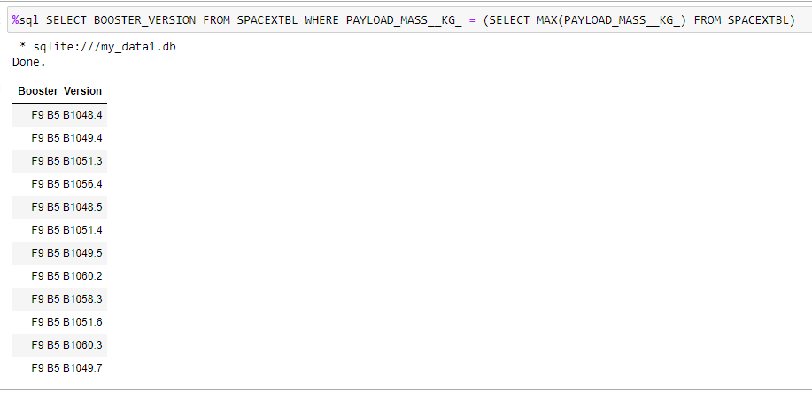
Boosters Carried Maximum Payload
Explanation:
A subquery is a query within another query. The outer query is called as main query and inner query is called as subquery.
A subquery in a WHERE clause can be used to qualify a column against a set of rows.
Here we made used of subquery in main query to list Boosters carrying max payload
31

Slide 32
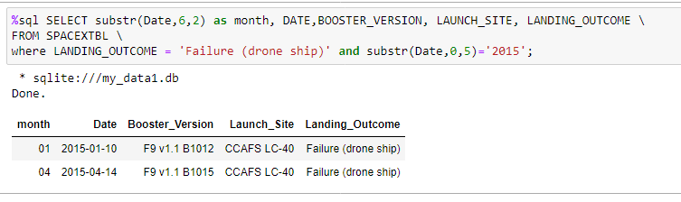
2015 Launch Records
Explanation:
The SUBSTRING() function extracts a substring from a string (starting at any position).
Here, we selected the failed landing_outcomes in drone ship, their booster versions, and launch site names for in

Slide 33
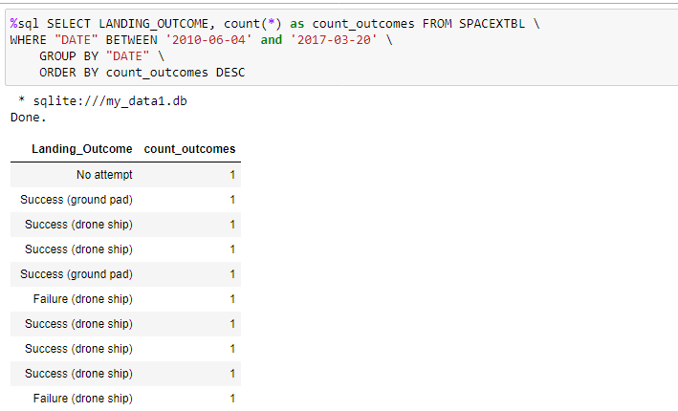
Rank Landing Outcomes Between 2010-06-04 and 2017-03-20
Explanation:
The COUNT() function returns the number of records returned by a select query.
The BETWEEN operator is used to test whether an expression is within a range of values.
The above query is used to rank the Landing outcome between 2010-06-04 and 2017-03-20

Slide 34

Section 3

Slide 35
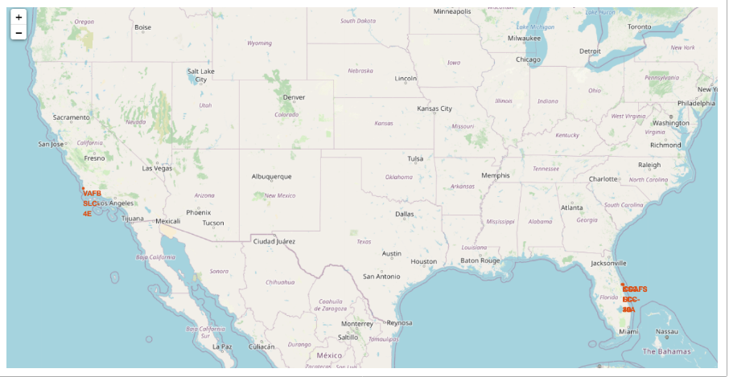
Global map for launch site location marker
All Launch Sites Location Marker for launch sites near USA Florida and California
We observe that SpaceX Launch sites are located in coastal areas of United States of America, Florida and California

Slide 36
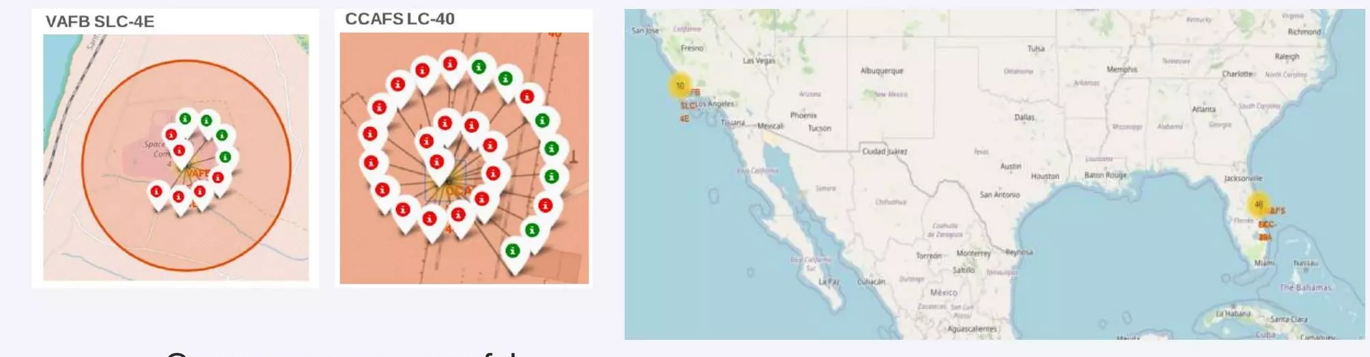
Color-labeled launch outcomes
Florida Launch Site:
Green marker shows successful launch and red marker shows failure

Slide 37
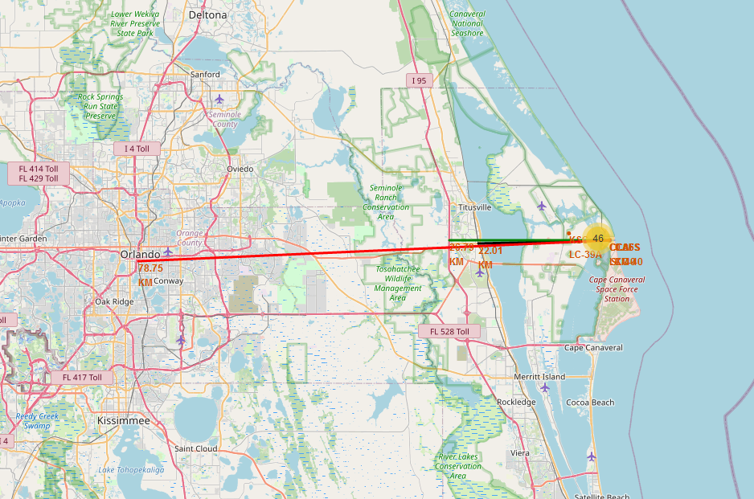
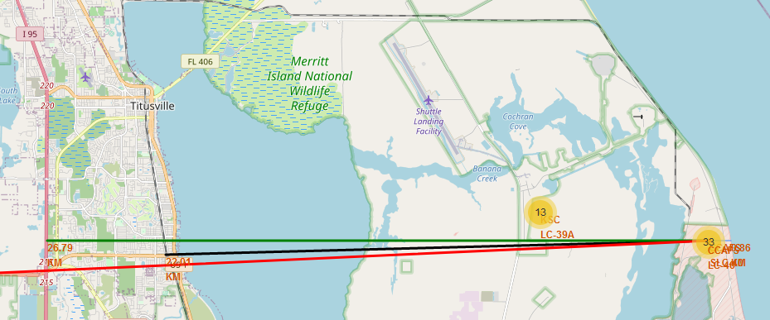
Distance of launch site to its proximities
Distance from CCAFS_SLC40 to:
Closest coast: ~900 m
Florida East Coast Railway: 22.0 km
Highway I 95: 26.8 km
Orlando: 78.75 km

Slide 38

Section 4

Slide 39
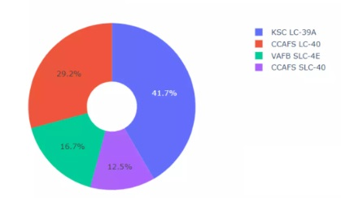
Count of successful launches for all sites
Pie chart showing success count for all sites
From the above chart we observe that KSC LC-39A as the successful launches of 41.7%, followed by CCAFF LC-40 which has successful launches of 29.2%, CCAFS SLC-40 has the lowest successful launches of 12.5%

Slide 40
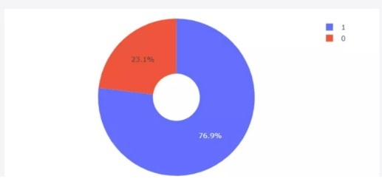
Launch site with highest launch success ratio
Pie chart showing launch site with highest launch success ratio
From the above chart, we observe that KSC LC-39A has the highest launch success rate of 76.9% where as its the failure rate is 23.1%

Slide 41
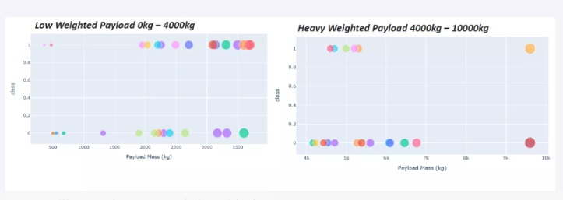
Payload vs. Launch Outcome
Scatter Plot of Payload vs. Launch Outcome
The above Scatter Plot shows the Payload vs. Launch Outcome for all sites, with different payload selected in the range slider. We can observe that success rate for low weighted payloads is higher than the heavy weighted payload.

Slide 42

Section 5

Slide 43
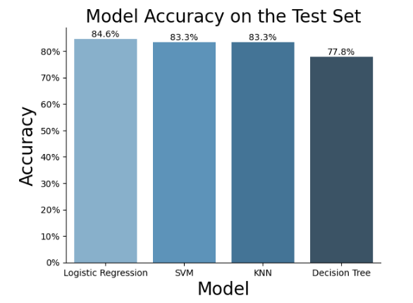
Classification Accuracy
From the bar chart we observe that Logistic Regression has the heighest classification accuracy of 84.6%, followed by SVM and KNN each having classification accuray of 83.3% respectively. Finally the classification accuracy of Decission Tree is 77.8% which is lowest among all.

Slide 44
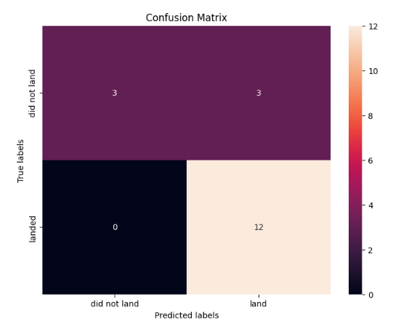
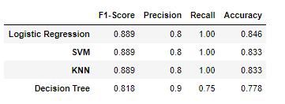
Confusion Matrix
Explanation:
The best results are achieved using Logistic Regression, with accuracy of 84%.
Examining the confusion matrix, we see that logistic regression can distinguish between the different classes. We see that the major problem is false positives

Slide 45
Conclusions
Low weighted payloads perform better than high weighted payloads
Success rate is directly proportional to time (in years)
Success rate may strongly depend payload mass and orbit.
CCAFS-SLC 40 is the most used launch site.
Launches from the site of CCAFS SLC 40 are significantly higher than launches form other sites
CCAFS-SLC 40 has most of failures specially in the early stage
Orbit GEO, HEO, SSO, ES-L1 has the highest success rate
GTO has the lowest success rate where as SSO (polar low orbit) the highest one.
We can conclude that Logistic Regression classification algorithm has the best performance with accuracy of 84.6%.
The classification algorithms SVM and KNN has prediction accuracy of 83.3% and the classification accuracy of Decision Tree is 77.8% .
For the given dataset, SVM, KNN, Logistic Regression model achieve best in terms of predictive accuracy

Slide 46
Appendix
GitHub Repository Link for IBM Data Science Capstone project :
https://github.com/shehla1739/Applied-Data-Science-Capstone

Slide 47


